Slide 1
Lesson One
Create MVC Web Application
Dragos Rosca
Automatica si Calculatoare 2018

Slide 2
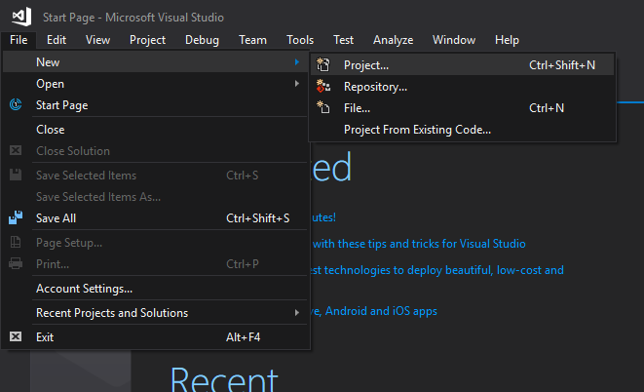
Create Project
Open File menu
Choose New
Click Project…
Or use the shortcut
Ctrl + Shift + N
This requires that your environment settings are set to C# developer

Slide 3
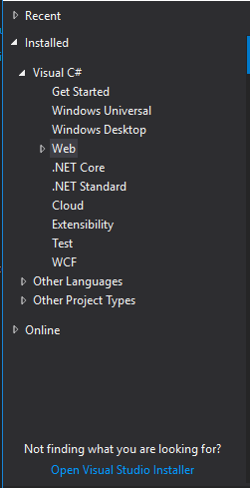
Create Project
On the left menu, expand:
Installed
Visual C#
Web

Slide 4
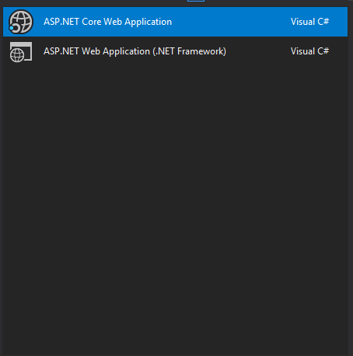
Create Project
On the middle part select
ASP.NET Core Web Application

Slide 5
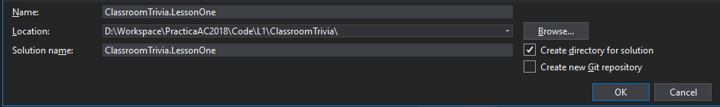
Create Project
On the bottom please name your application and choose a location

Slide 6
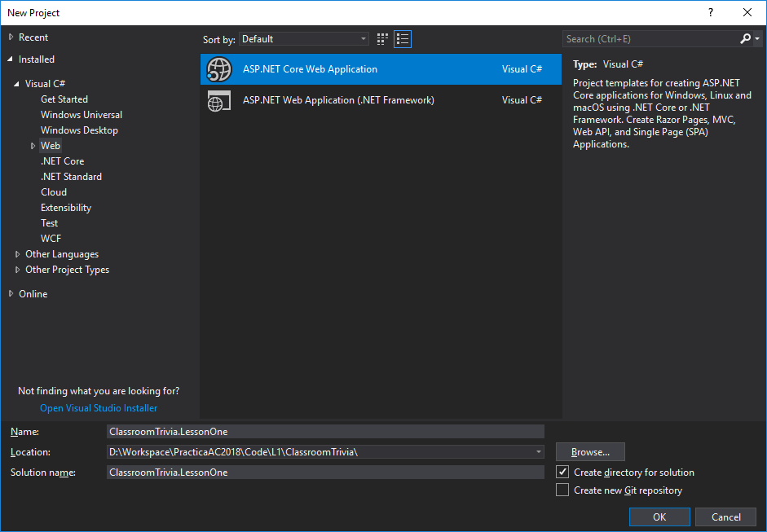
Create Project
Click OK

Slide 7
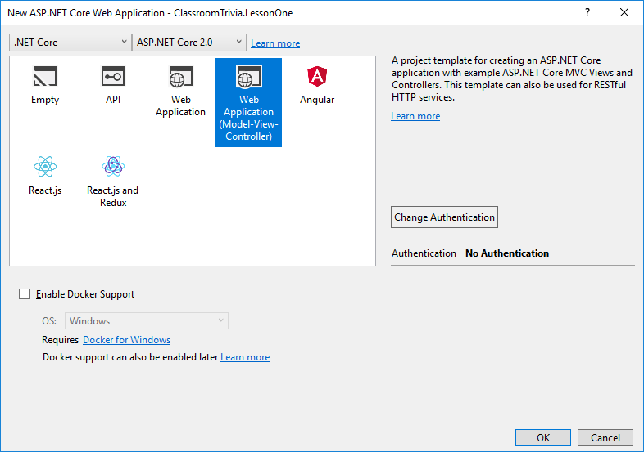
Create Project
On the next window choose “Web Application (Model-View-Controller)”
Click OK

Slide 8
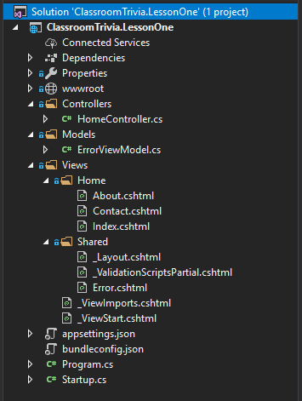
Create Project
At this point your Solution Explorer window should look like this
You should be able to build and run the solution

Slide 9
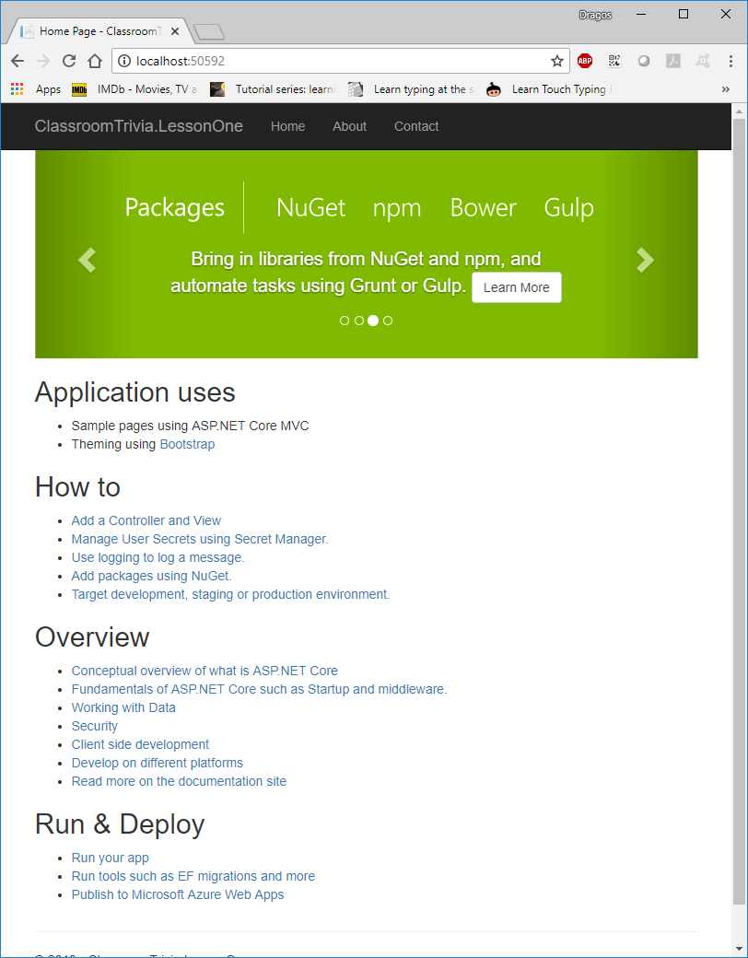
Create Project
Running the solution should open a browser looking something like this

Slide 10
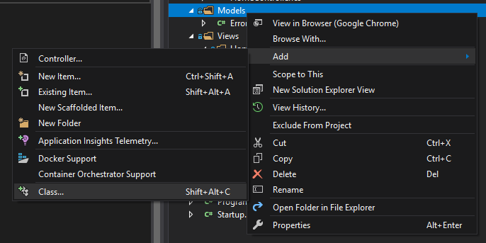
Adding Model Class
Right click on the Models folder
Select Add
Click Class…

Slide 11
Adding Dependences
No dependences are required. The ones we need are included in “Microsoft.AspNetCore.All”

Slide 12
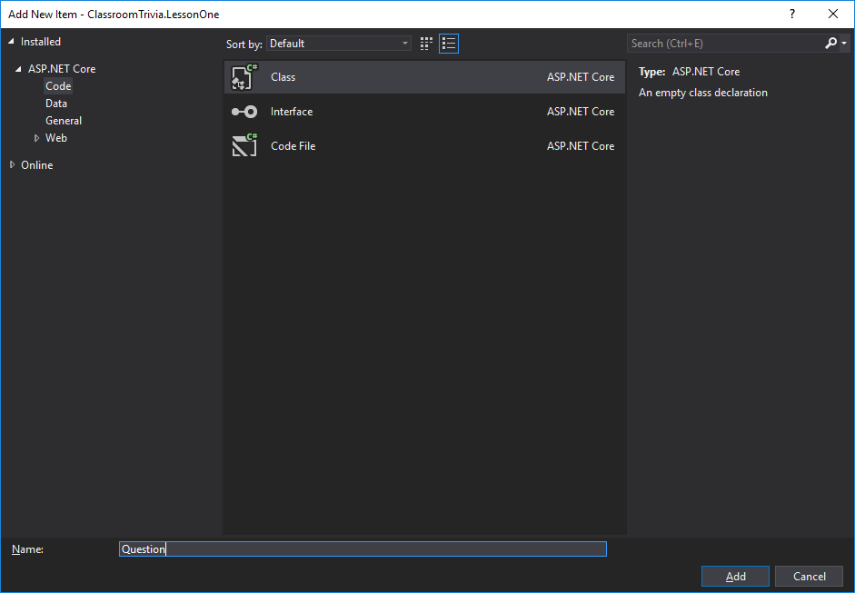
Adding Model Class
On the Add New Item window type in the name of the class (Question) and click Add

Slide 13
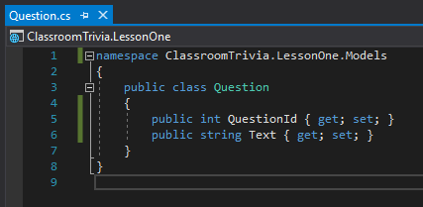
Adding Model Class
In the Question class add two new properties
namespace ClassroomTrivia.LessonOne.Models
{
public class Question
{
public int QuestionId { get; set; }
public string Text { get; set; }
}
}

Slide 14
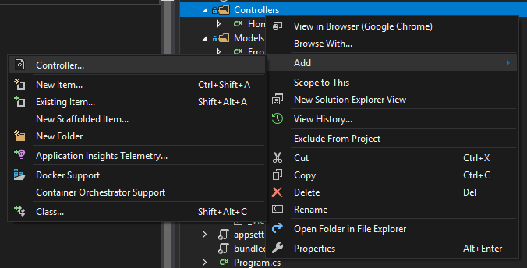
Adding Controller
Right click on the Controllers folder
Select Add
Click Controller…

Slide 15
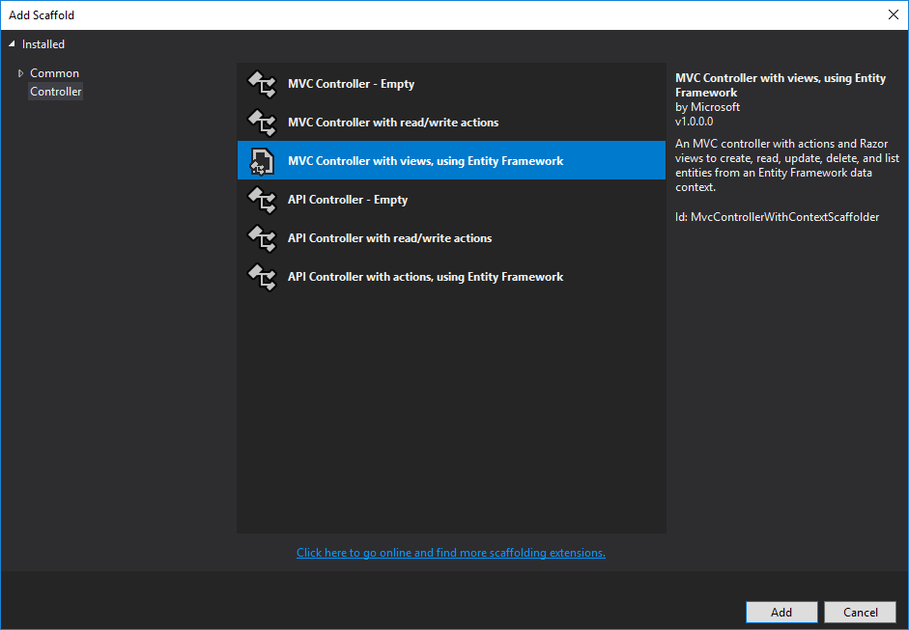
Adding Controller
On the Add Scaffold window select “MVC Controller with views, using Entity Framework”
Click Add

Slide 16
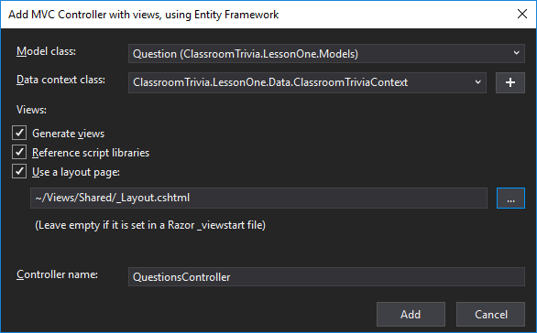
Adding Controller
Model class:
Select the Question class
Data context class:
Click the + button
Change the name to
“ClassroomTrivia.LessonOne.Data.ClassroomTriviaContext”
Controller name:
QuestionsController

Slide 17
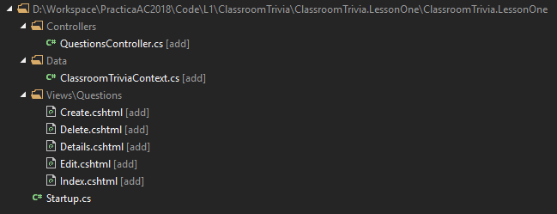
Adding Controller
The list of files that should be added and modified

Slide 18
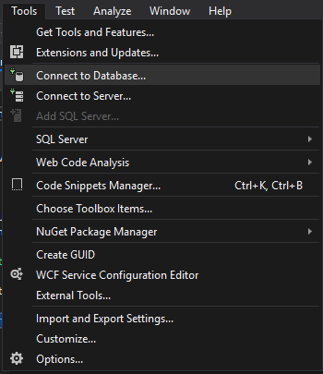
Adding Database Connection
In the Tools menu click Connect to Database…

Slide 19
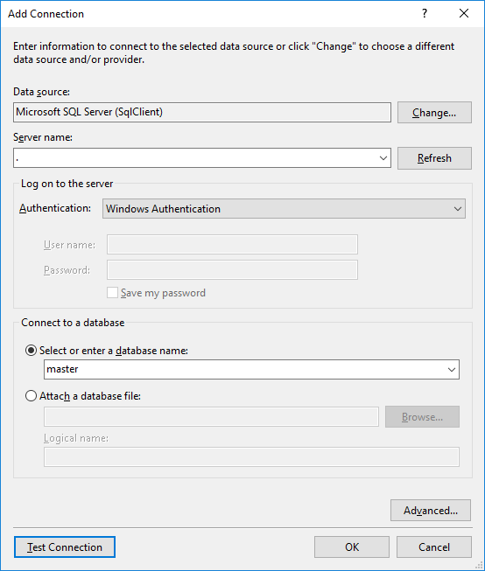
Adding Database Connection
In the Add Connection window
Server name: “.” or “localhost” or “.\MSSQLSERVER01”
Connect to a database
Select or enter a database name:
For now we will select master but this will not be used
You should Test Connection first
Click OK

Slide 20
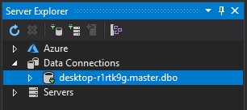
Adding Database Connection
On the Server Explorer window you should see something like this
Click your database connection

Slide 21
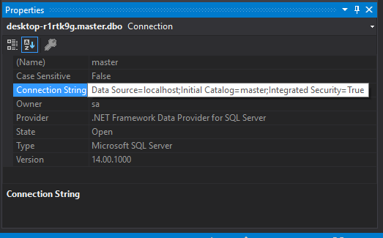
Adding Database Connection
Now the property window should be populated with a standard connection string format.
Copy the connection string

Slide 22
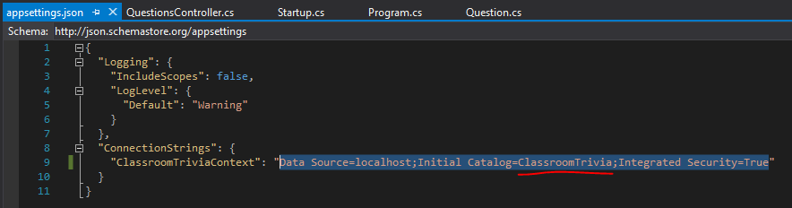
Adding Database Connection
Open the appsettings.json file
Replace the connection string with the one you coped
Change the “Initial Catalog” value
from “master”
to “ClassroomTrivia”

Slide 23
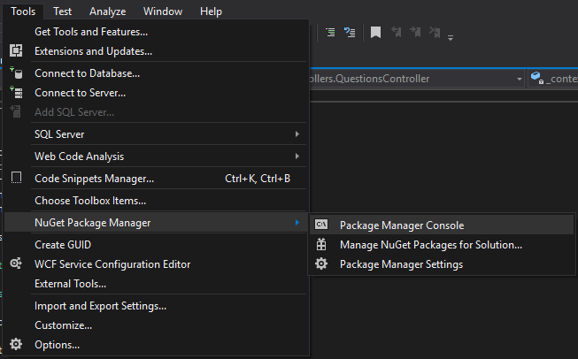
Create Database
From Tool menu
Select NuGet Package Manager
Click Package Manager Console

Slide 24
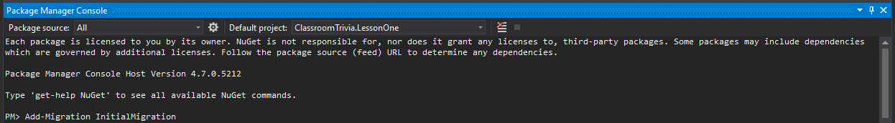
Create Database
In the Package Manager Console type
Add-Migration InitialMigration
If successful you should see this message

Slide 25
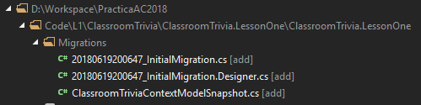
Create Database
This process should create the following files

Slide 26
Create Database
This process should create the database ClassroomTrivia

Slide 27
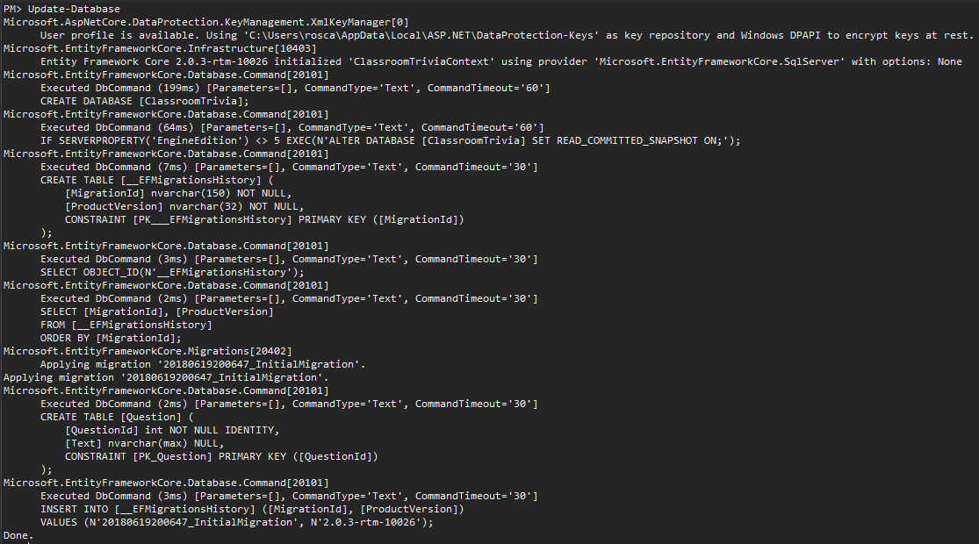
Create Database
To create database type
Update-Database

Slide 28
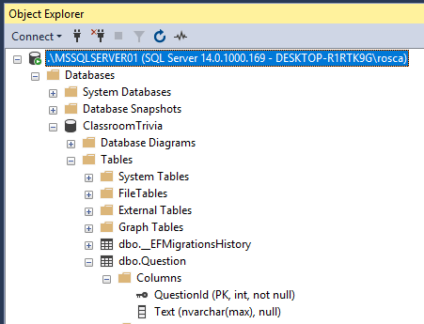
Create Database
You should see now a database called ClassroomTrivia
This should contain 2 tables
__EFMigrationsHistory
Question
By convention the property named <Class/Table name>Id becomes the primary key

Slide 29
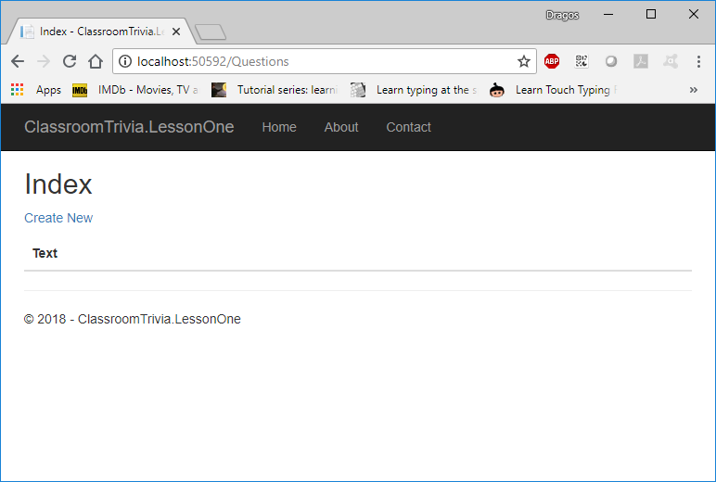
Final Test
Run the project
Add “/Questions” to the address
Create New questions
Look in the database

Slide 30
Lesson One
Congratulation!
Automatica si Calculatoare 2018

